Slide 1
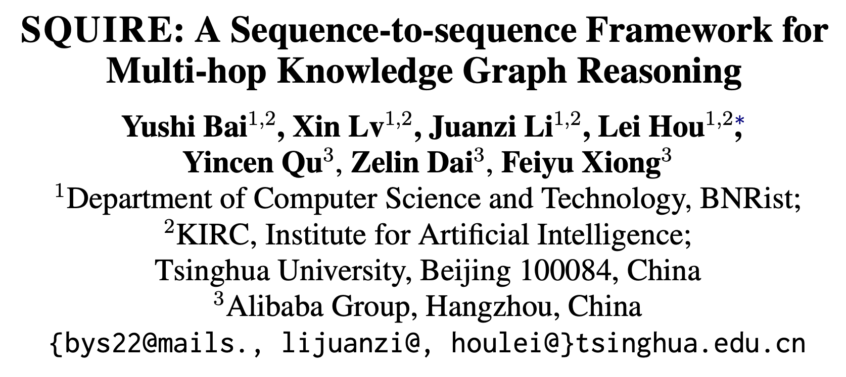

Slide 2
Key points
Multi-hop reasoning over knowledge graphs (KG) not free text
Replaces RL with sequence-to-sequence

Slide 3
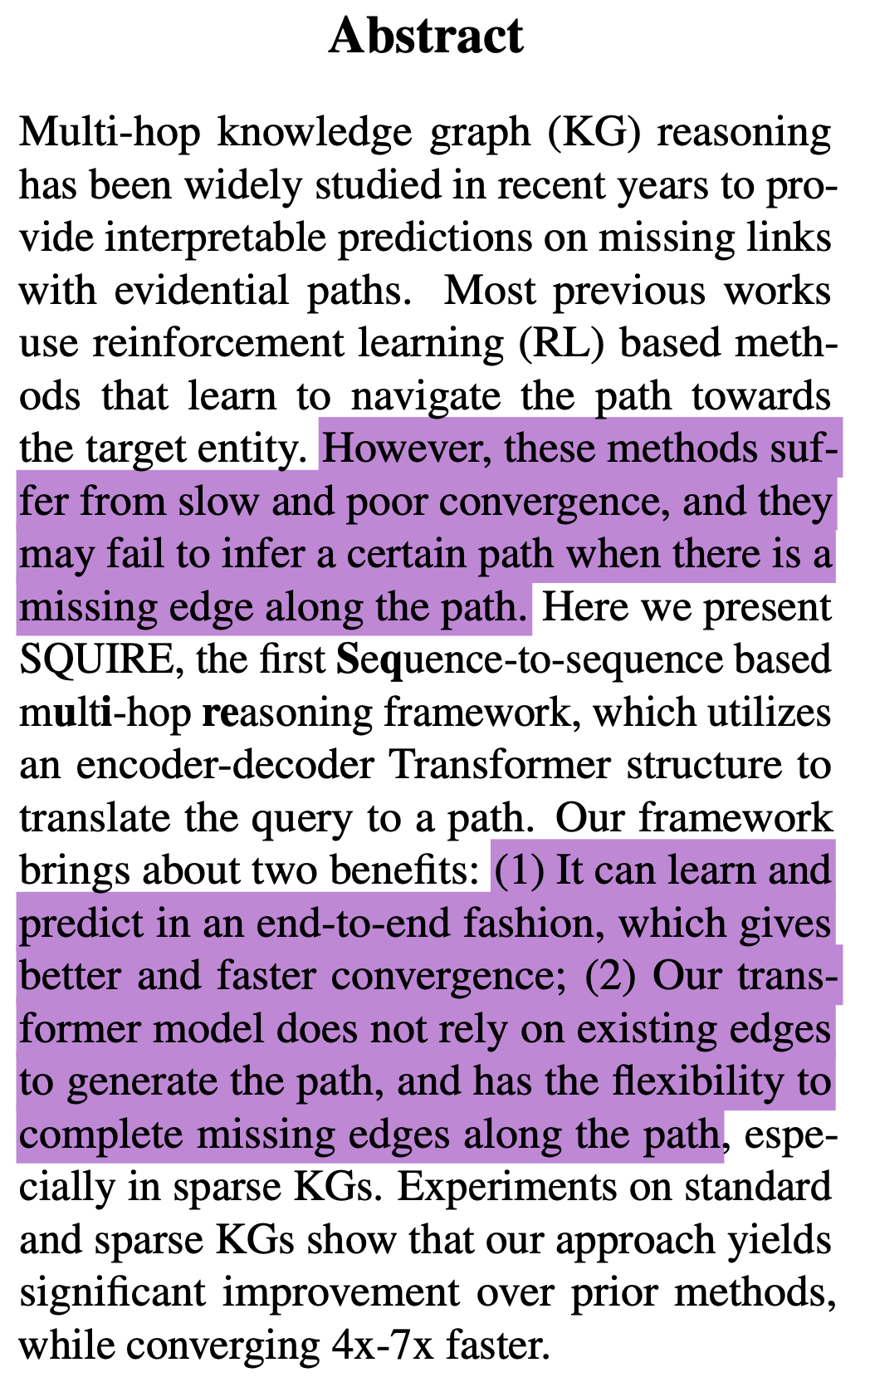

Slide 4
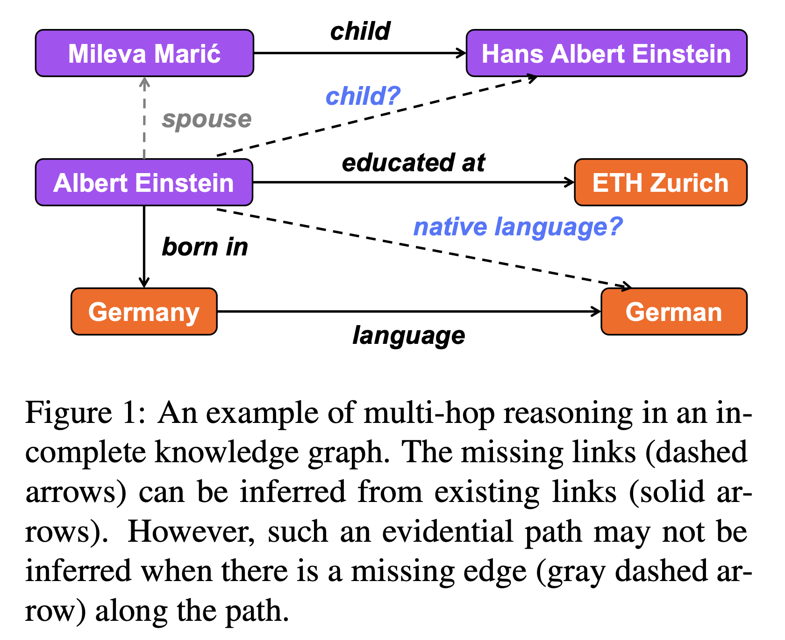
Multi-hop reasoning over KG
Blue edges are inferred

Slide 5
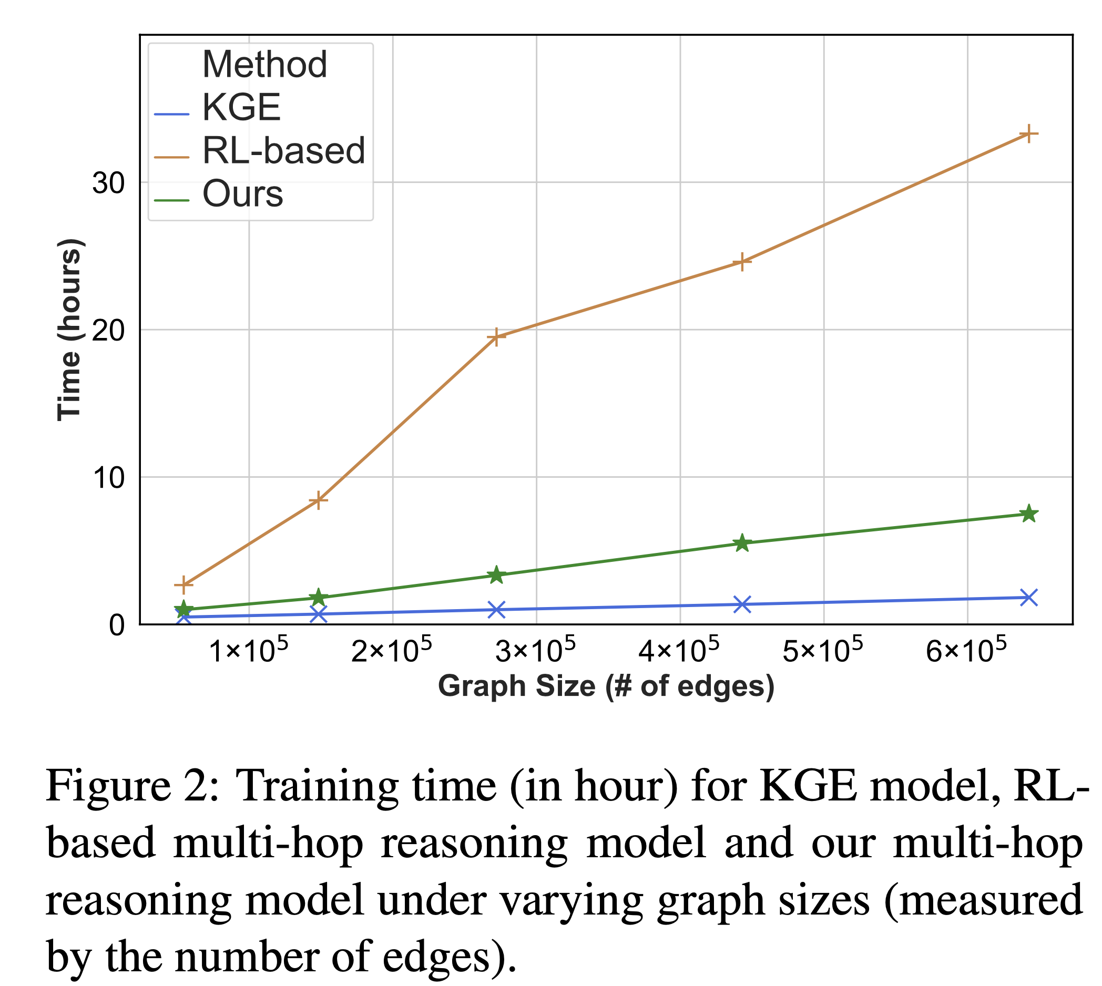
Three strategies for multi-hop reasoning over KGs
RL:
Learns slowly
Does not handle sparse KGs

Slide 6
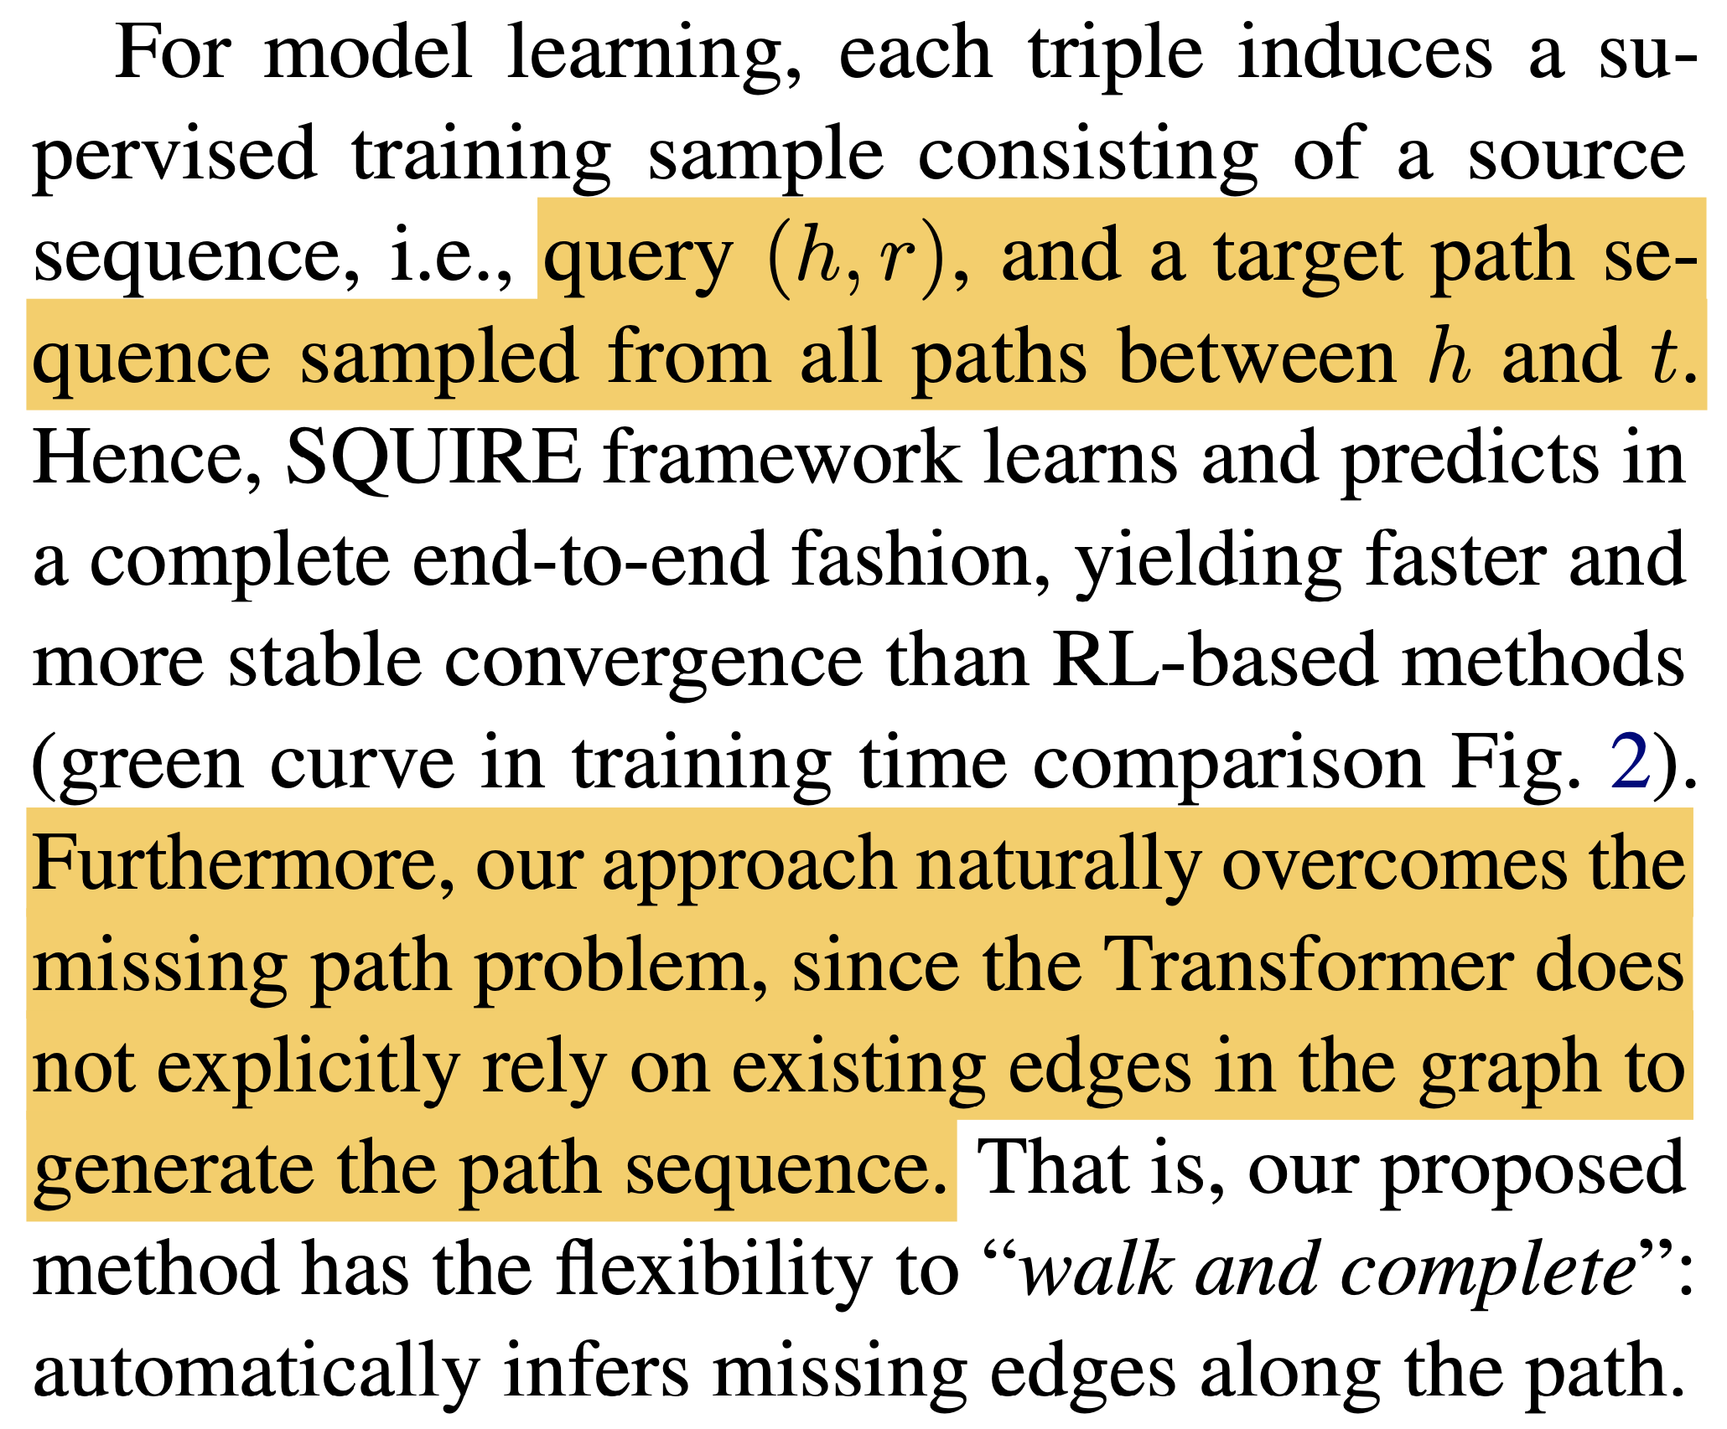
Problem setup

Slide 7
Two problems
No supervision for the generation of target paths for training
If all possible paths are used → “noisy sample” problem
They use rule-enhanced learning to mitigate this problem
The paths in training may be different from the paths generated at inference: “history gap” problem
Iterative training that iteratively aggregates new paths to the training set based on the model’s previous predictions, adapting the model to the distribution of history tokens it induces.

Slide 8
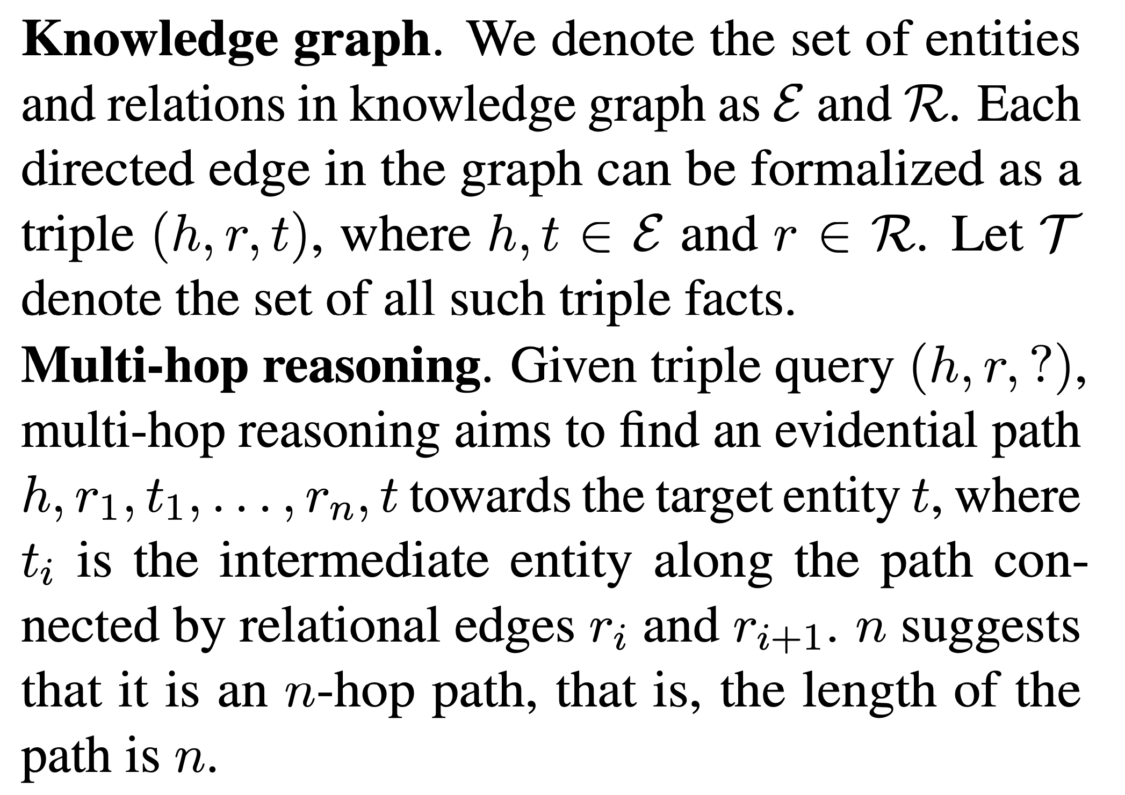
Methodology: Preliminaries

Slide 9
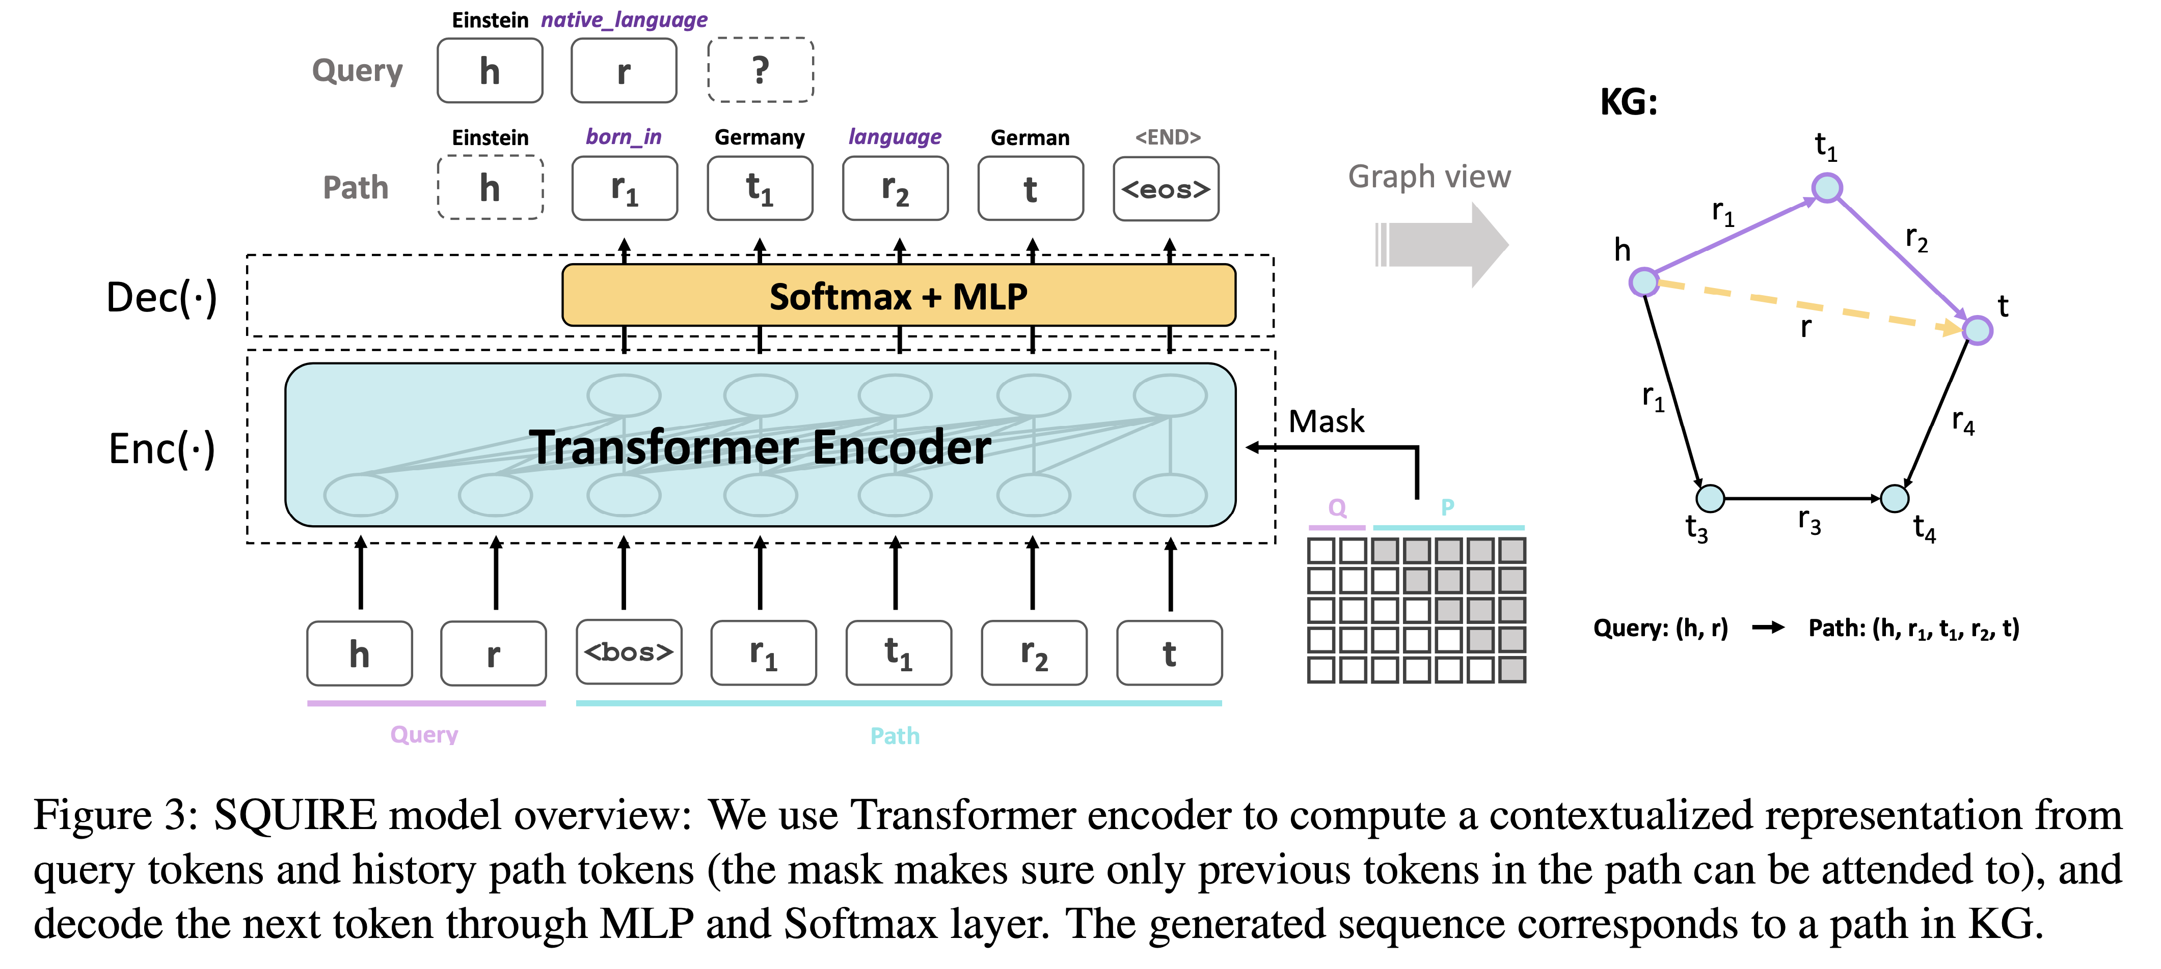
Framework
Max path length = 3 relations
Where do “gold” paths come from?

Slide 10
Rule-enhanced learning
“Gold” training paths are generated using the AnyBURL algorithm (Meilicke et al., 2019)
Each rule decomposes a single relation into the composition of multiple relations (including inverse relations).
A confidence score is given along with each rule, and we choose the rules with confidence scores larger than some threshold and treat them as “golden rules”.

Slide 11
Rule-enhanced learning
For example, if one rule for relation r is r(X,Y) → r1(X,A1) ∧ r2(A1,A2) ∧ · · · ∧ rn(An−1, Y ), we traverse the path from h to t along the relational edges r1, r2, . . . , rn.
If none of the rules lead to a valid path in the graph, we obtain the path by random sampling.

Slide 12
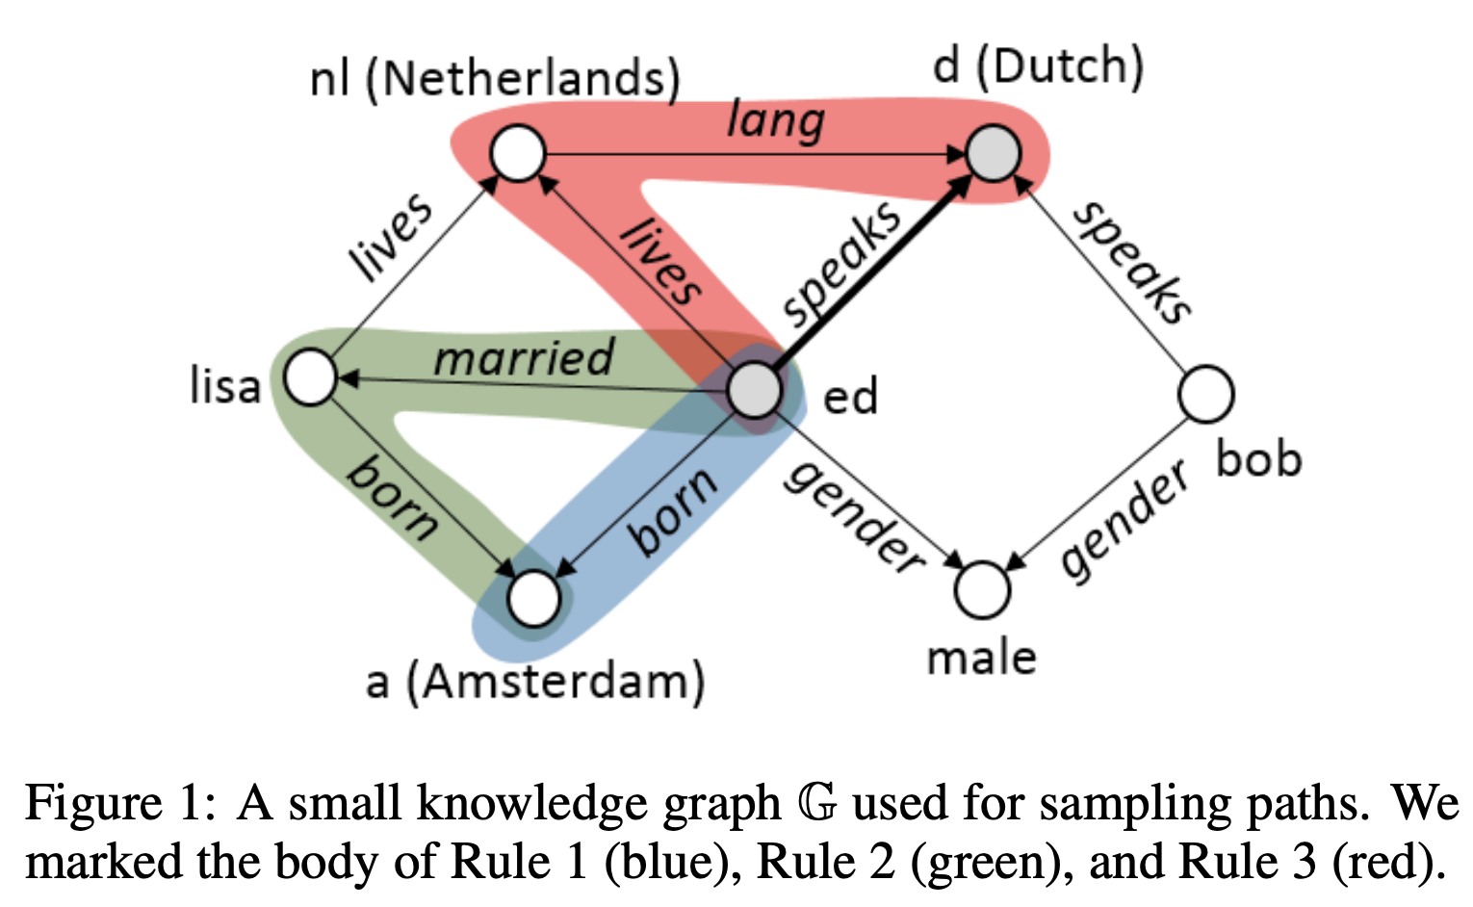
AnyBURL summary (1/3)

Slide 13
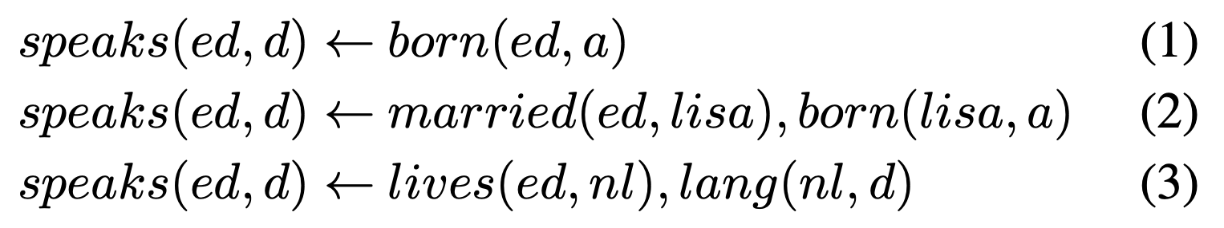
AnyBURL summary (2/3)

Slide 14
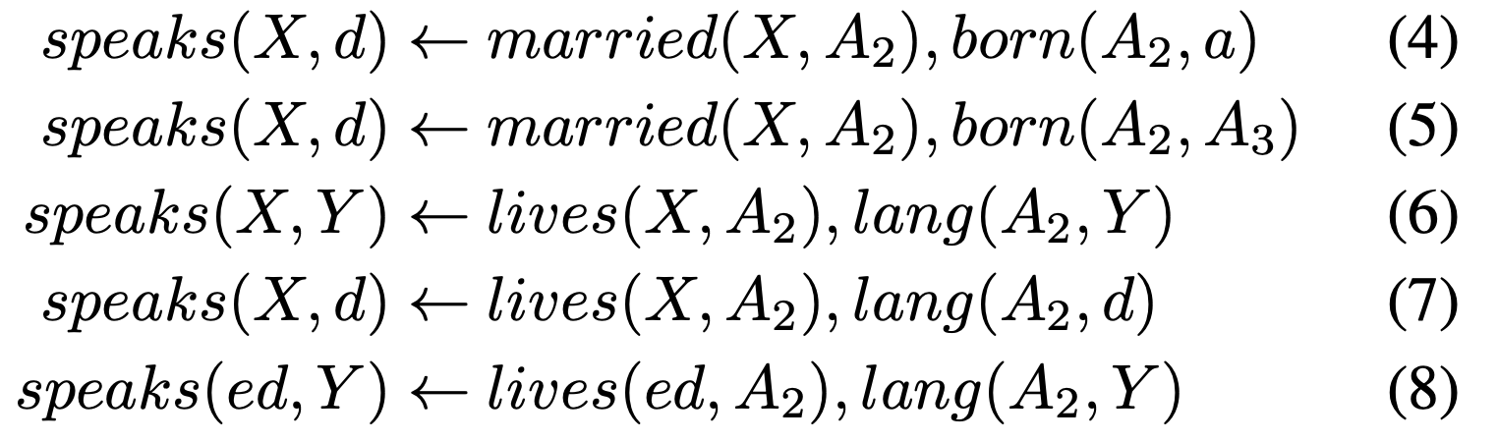
AnyBURL summary (3/3)
From these, they keep the rules with correctness > threshold

Slide 15
Iterative training
We propose a novel training strategy that iteratively aggregates new training data based on the model’s prediction to help the model adapt to its induced distribution of history tokens.

Slide 16
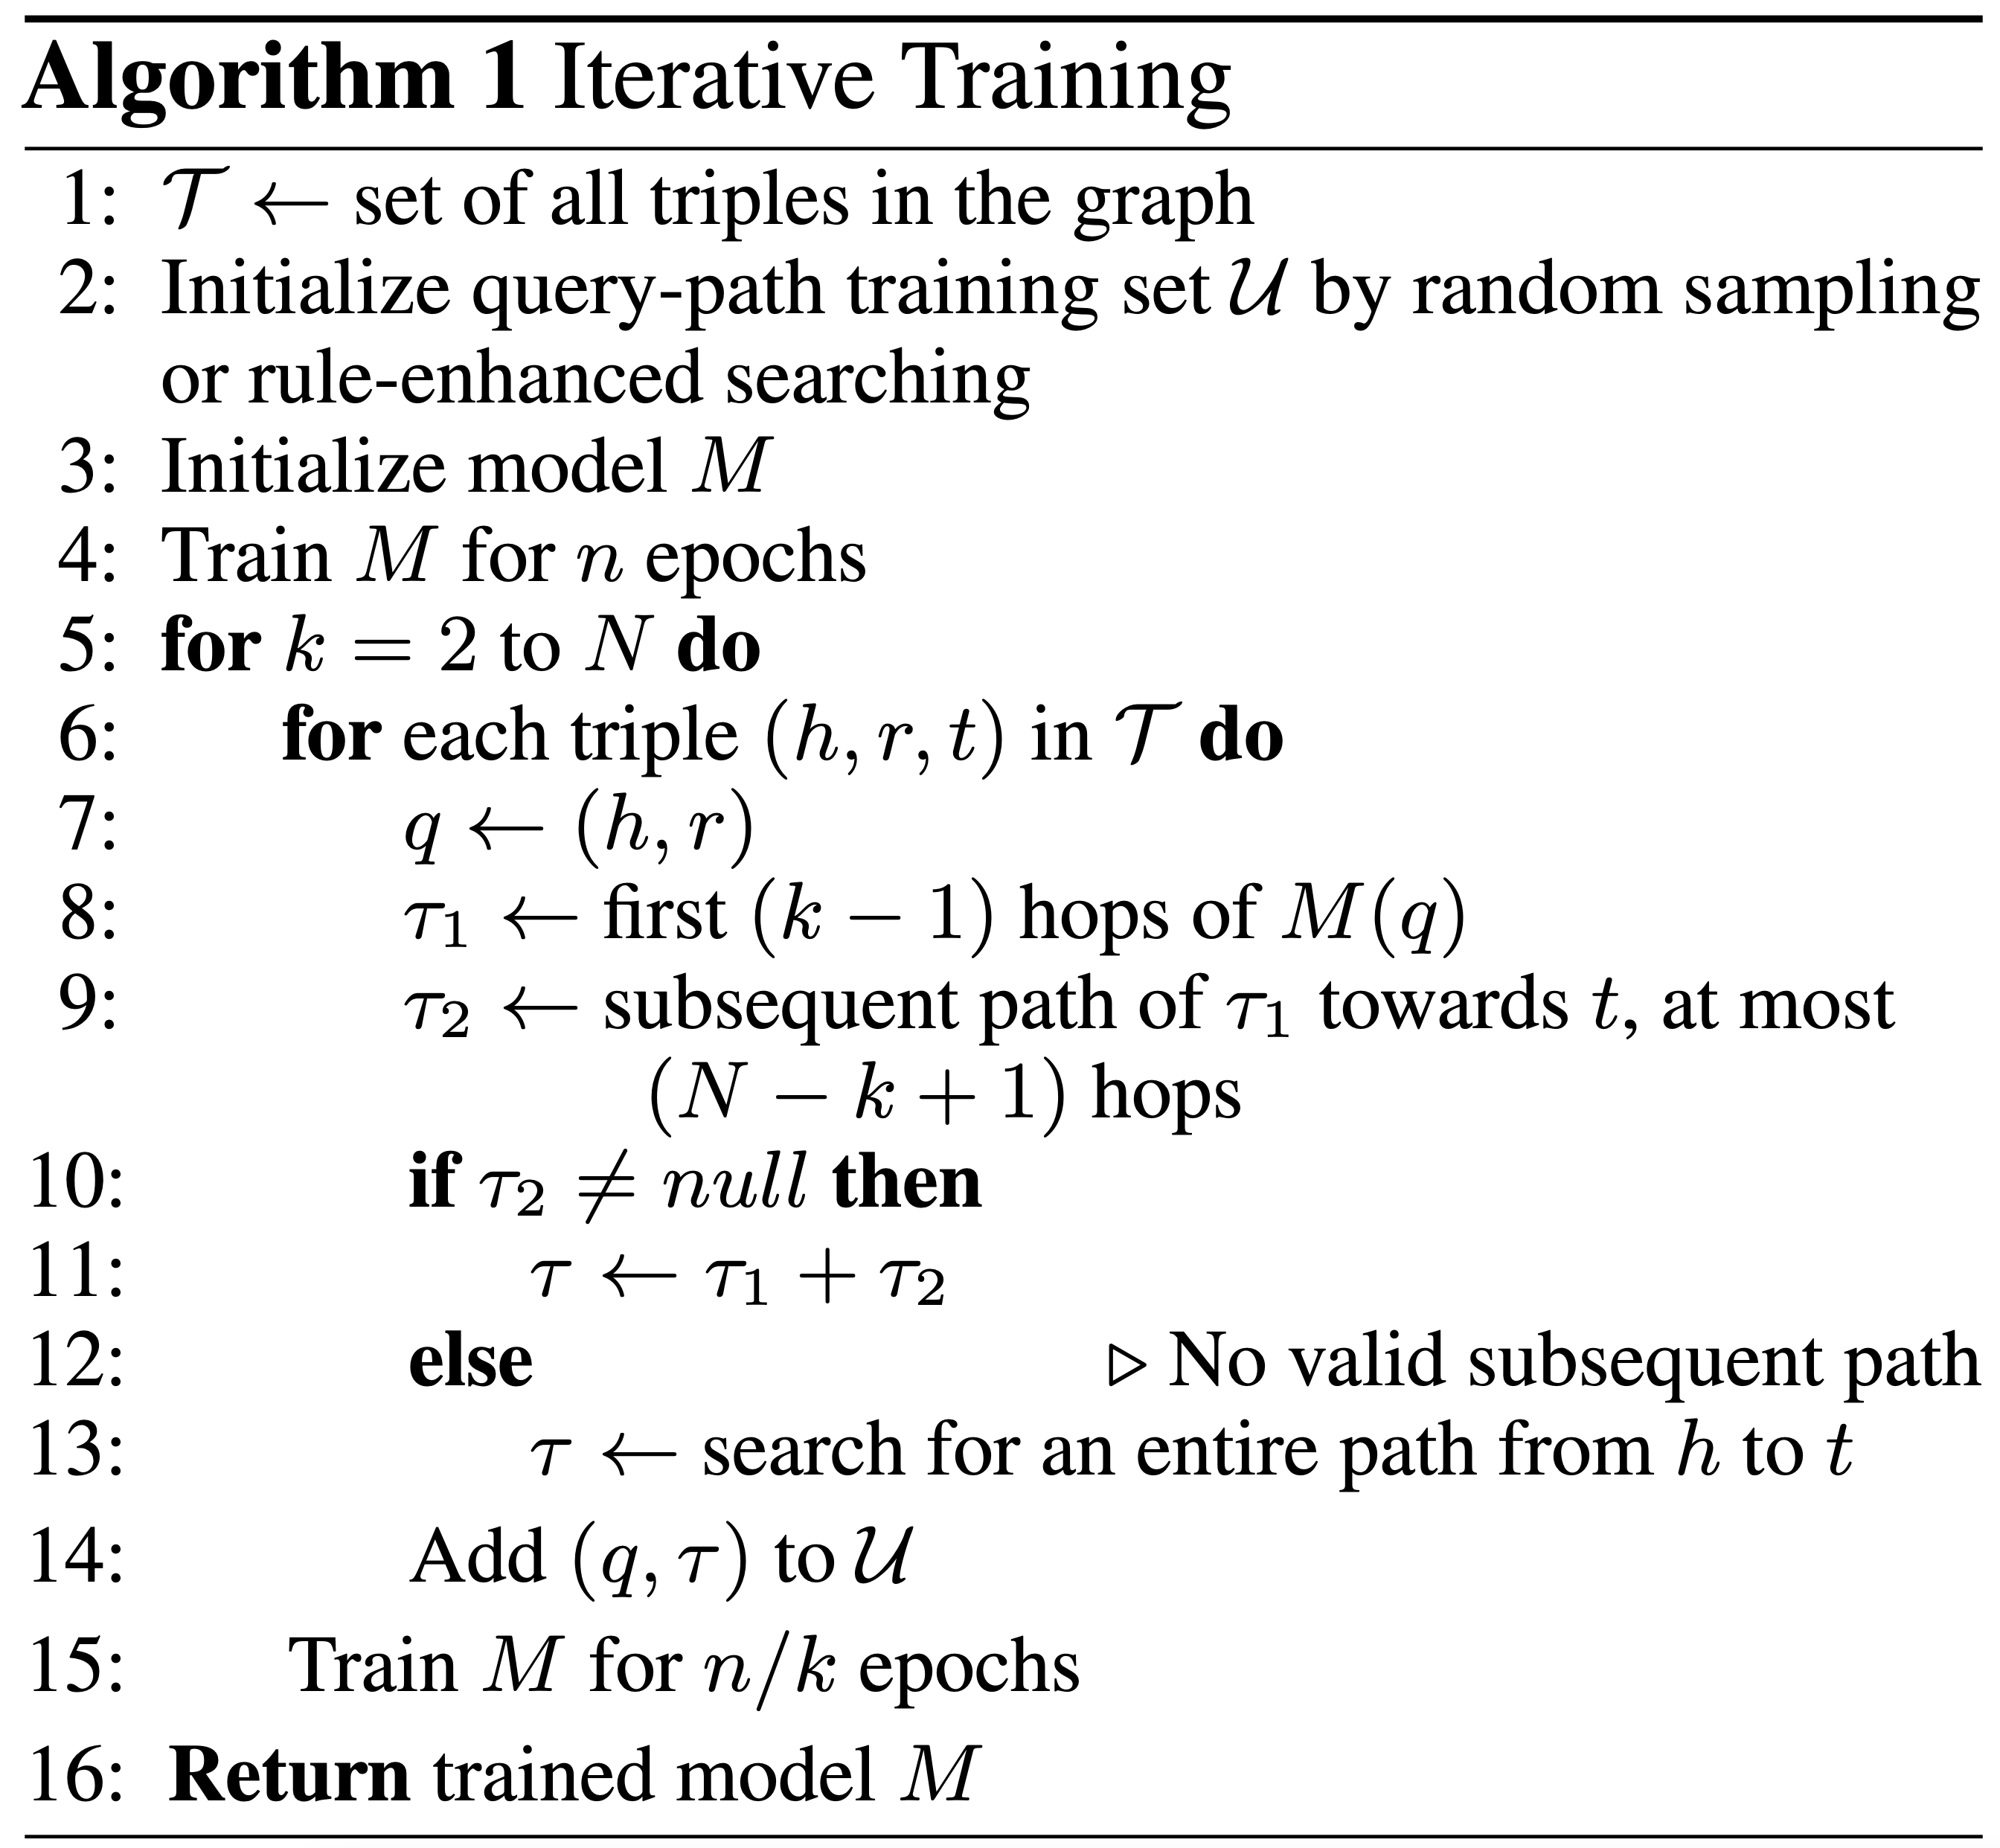
Iterative training

Slide 17
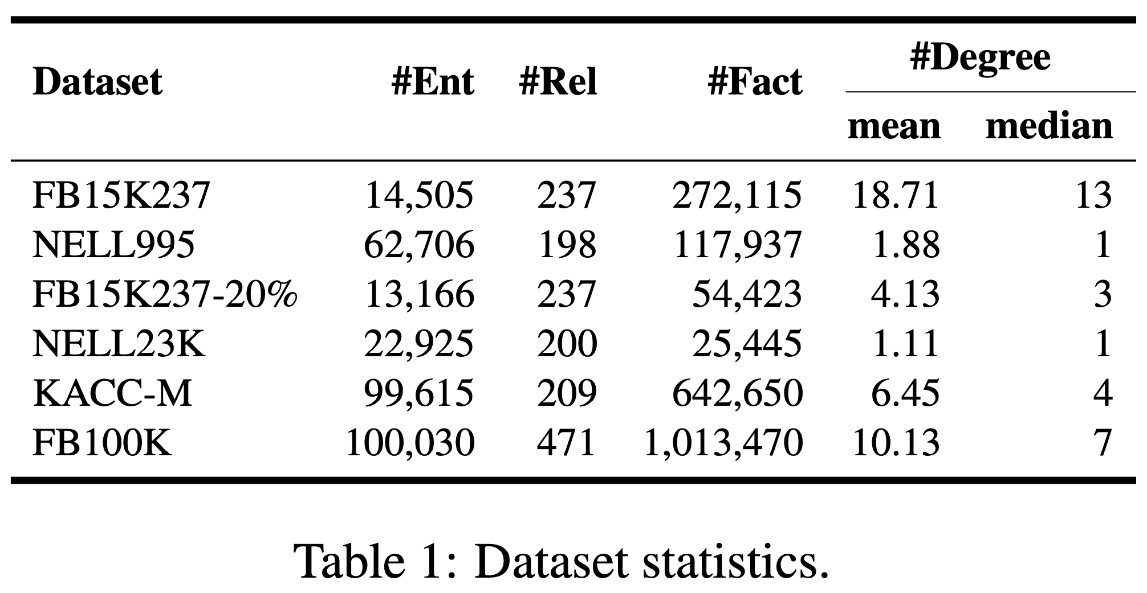
Datasets

Slide 18
Implementation details
During evaluation, we perform beam search to obtain a list of multi-hop paths, along with log-likelihood as their scores.
To prevent the model from giving higher scores to shorter paths, we further divide the log-likelihood score by the length of the path.
We sort the target entities according to the maximum score among all paths that lead to them.
The score for each entity is the summation of the probability of all generated paths that lead to it, and we sort the target entities according to their total probability.
In addition, we consider adding self-consistency (Wang et al., 2022) into decoding the target entity.

Slide 19
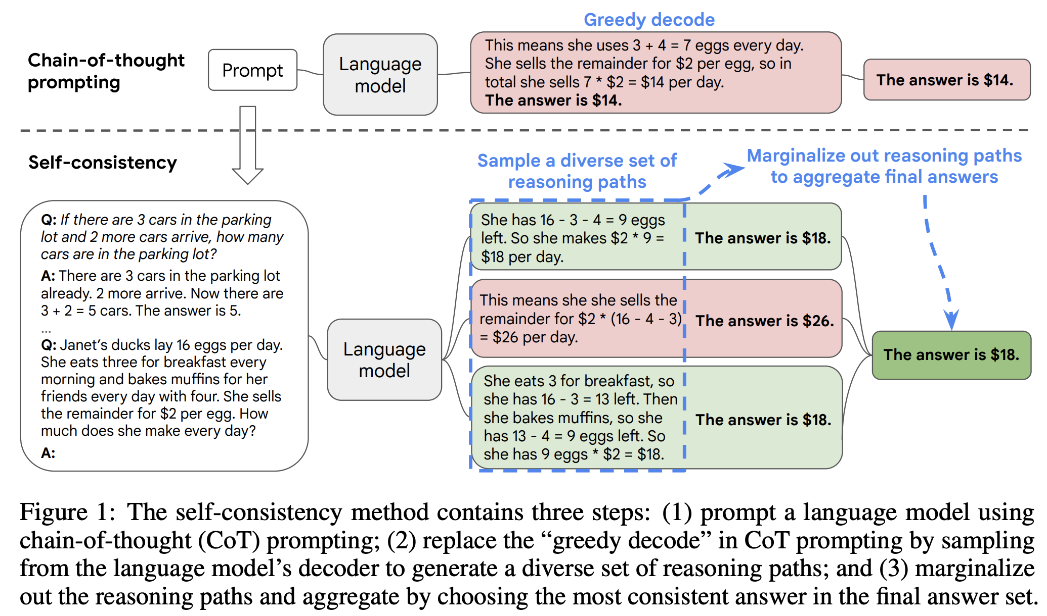
Self-consistency summary

Slide 20
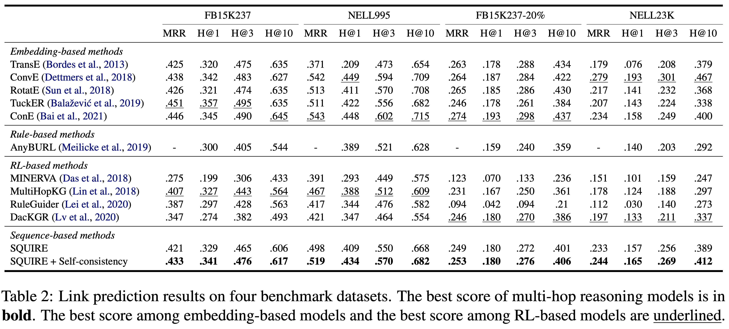
Main results
1. Sacrifice some performance for interpretability
2. Better than other RL-based approaches
3. Rules are comparable with RL…

Slide 21
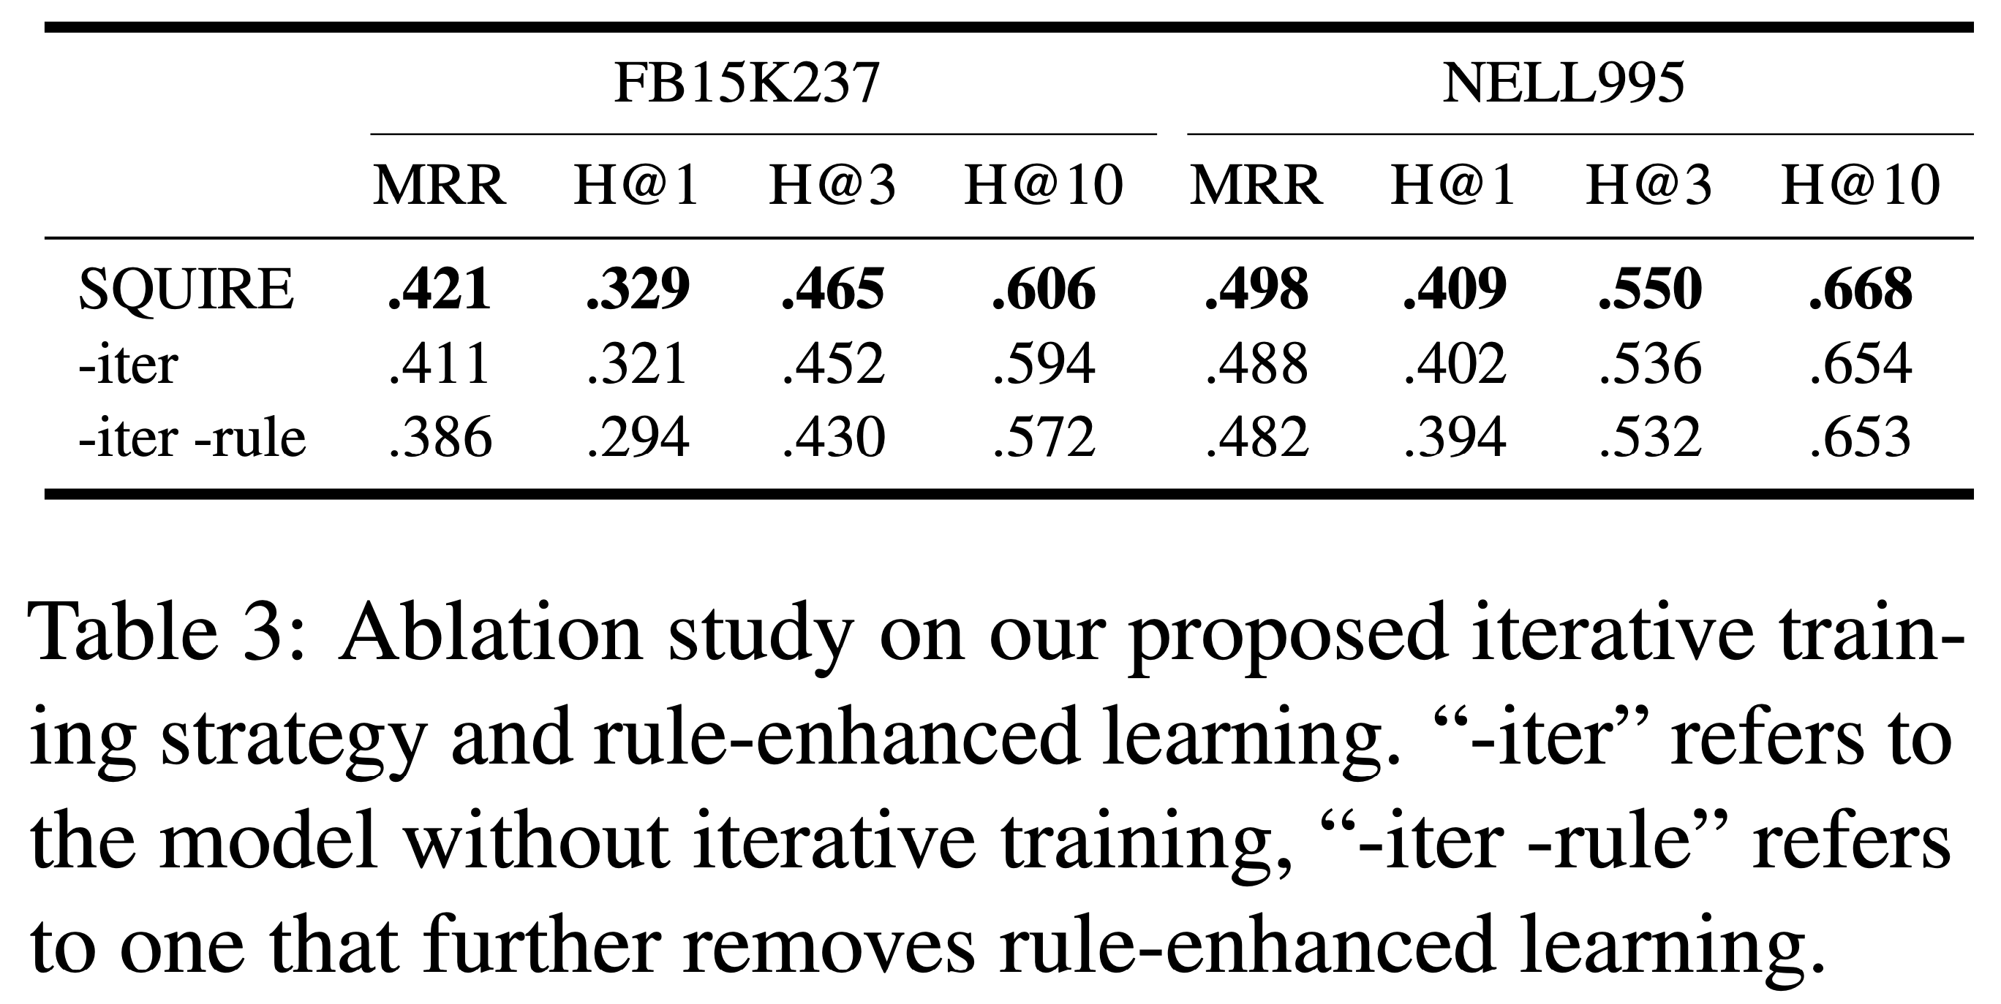
Ablation study

Slide 22
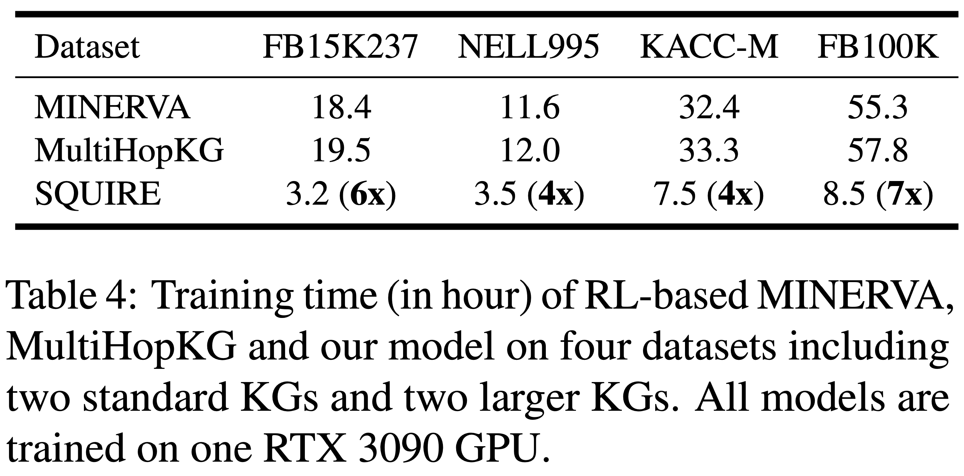
Training time of RL vs. seq2seq
SQUIRE wo/ iterative training here…

Slide 23
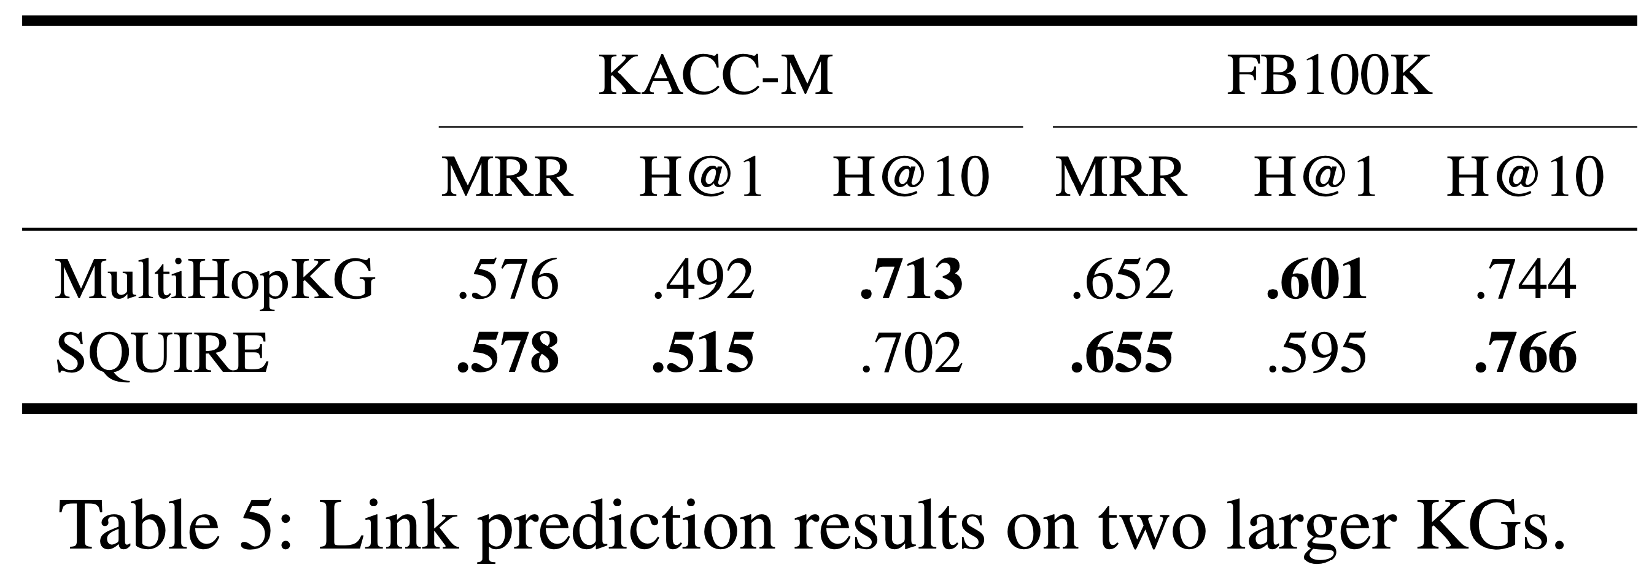
Performance is decent wo/ iterative training

Slide 24
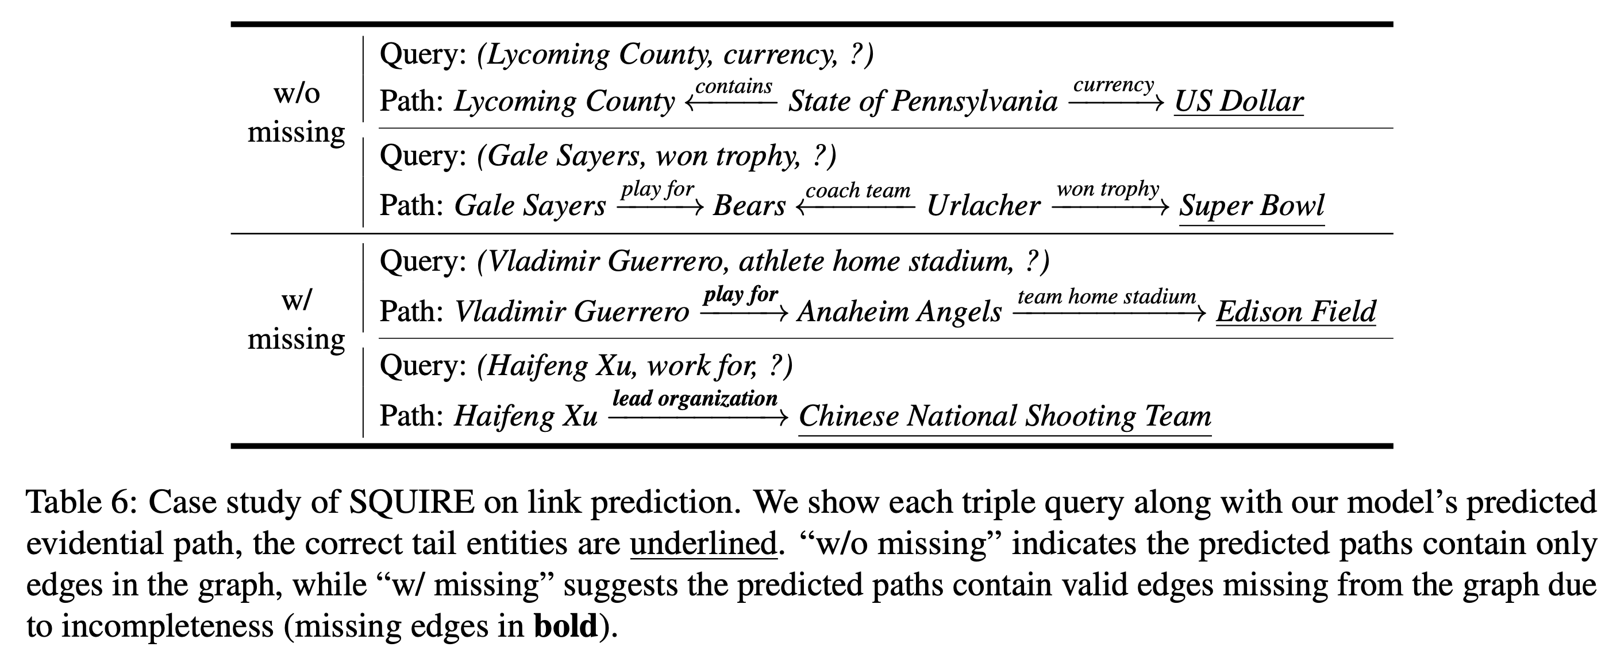
Interpretability evaluation

Slide 25
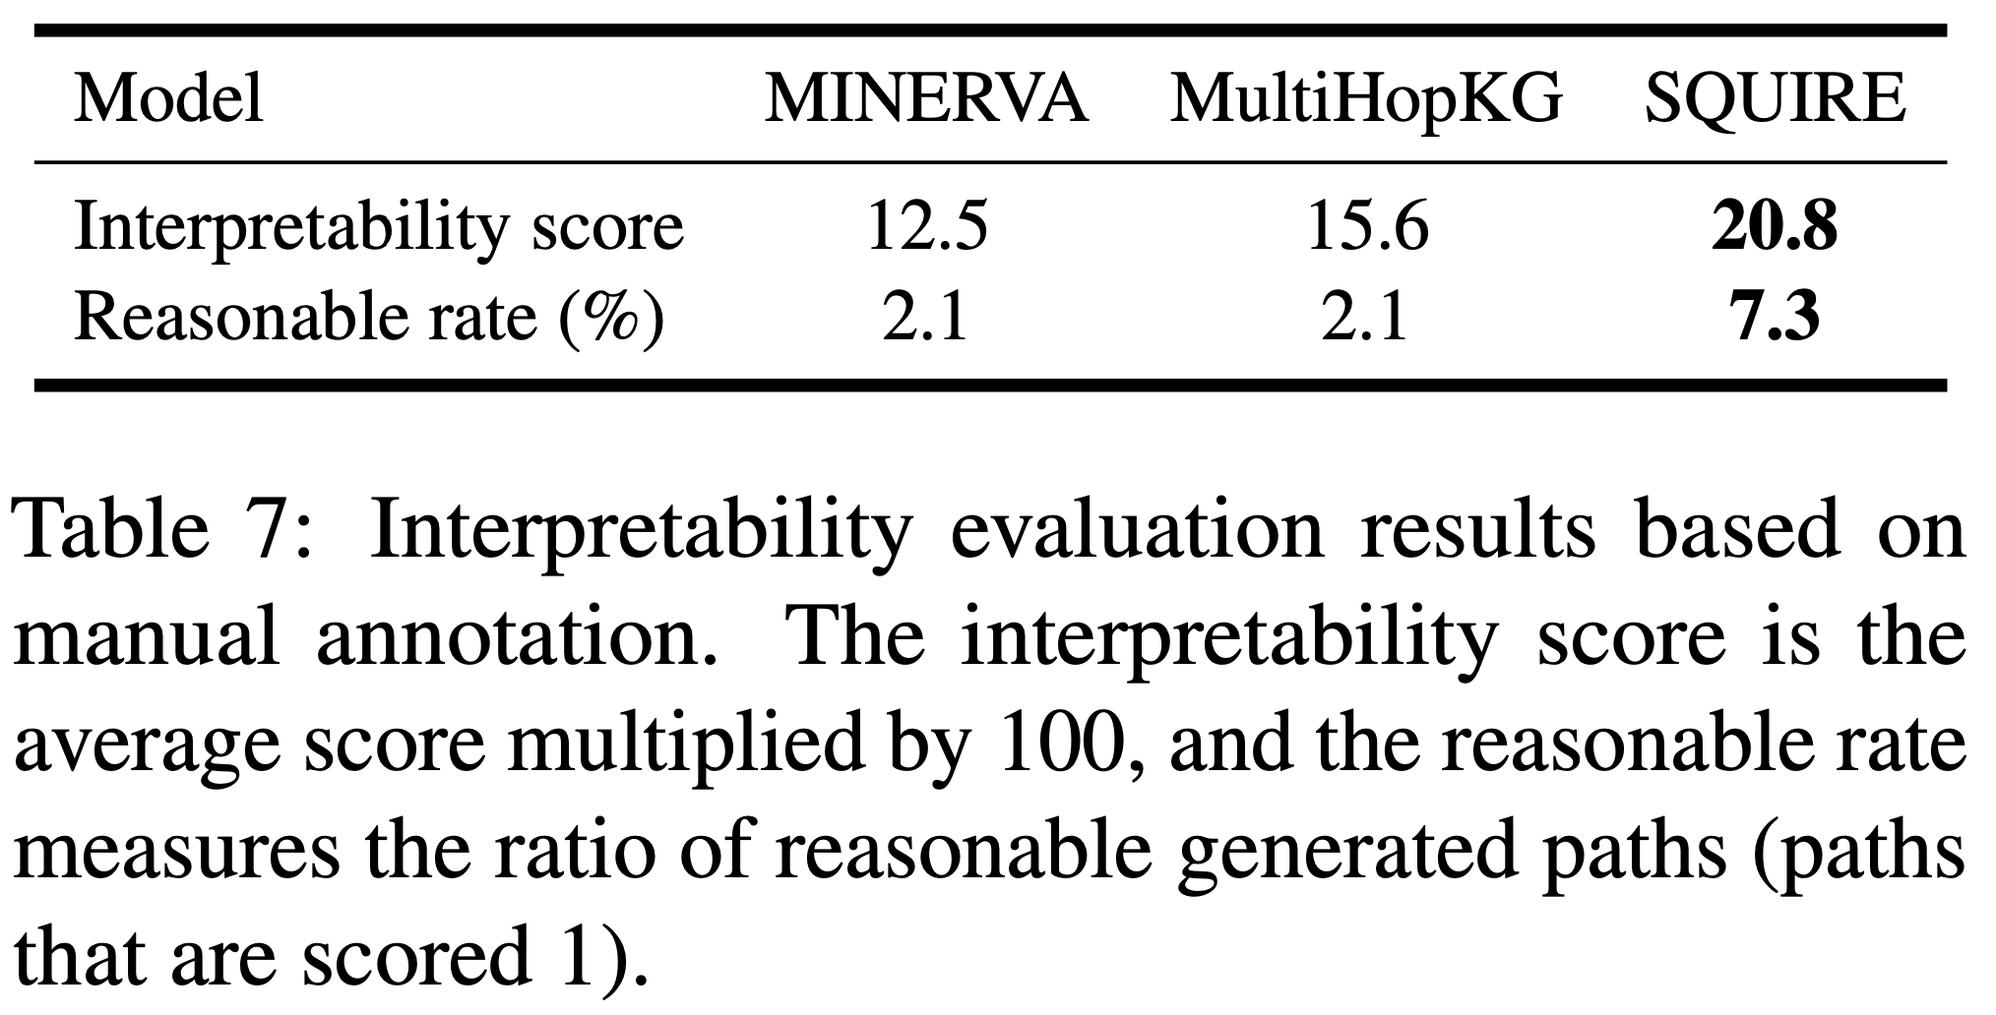
Interpretability evaluation

Slide 26
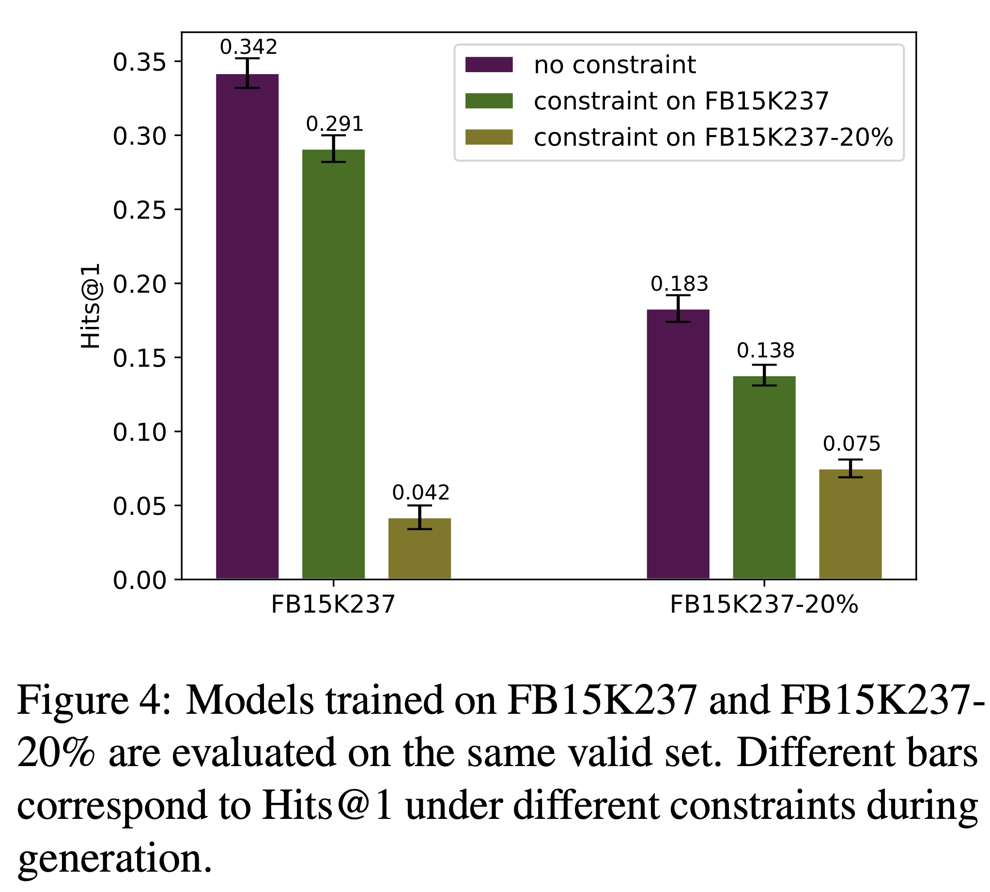
No-constraint inference in sparse setting

